Slide 1
WELLBEING WORKSHOP February 2021

Slide 2
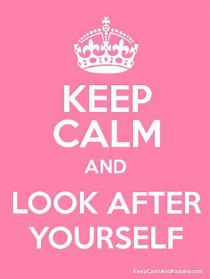
AIMS
To give you the tools you need to look after yourself.
Improve your physical and mental well-being
Assist you in making healthy choices.
The Royal College of Midwives | www.rcm.org.uk

Slide 3
Self-leadership
Notes:
We talk a lot about leadership and self leadership but a big par of that is understanding how we lead ourselves, its about how we set a course for our lives , how we might follow that course and then how we might need to correct as we go along the way. Is very much around self understanding and self reflection and what we’re going to do here before the rest of the presentation is take a bit of a deep dive int the issue of self care and what that really means.

Slide 4
Four pillars of self-leadership
Self-discovery
Knowing your core beliefs and values, and living by them
Self-acceptance
Accepting your strengths as well as your weaknesses – and learning from both
Self-management
Holding yourself accountable, ensuring you manage your time and resources effectively
Self-growth
Continually striving to improve yourself, creating development plans, being open to feedback, remaining curious
The Royal College of Midwives | www.rcm.org.uk
Notes:
So there’s been described these 4 pillars of self leadership and there's a lot of the word self in here. Which for some can be a bit uncomfortable., it can be difficult to examine ourself and our own behaviour at times, but a lot of what were thinking about is how we can understanding our own lives and what we can do to improve certain elements within that. So these 4 pillars are really starting with self discovery, whenever we talk about self discovery we always say this is begins with understanding ourselves and that a central theme in emotional intelligence the importance here of taking time to learn and understand your values and if you can start from there then you can look at whats working and not working so well. The second pillar is self acceptance and this is about accepting your strengths as well as weaknesses. Sometimes weaknesses are call ‘areas for development’ however I tend to think, whats wrong with having weaknesses were not meant to be super human and this is about stopping the self criticism and self sabotage that we sometimes fall prey to. We sometimes focus too much on our weaknesses and as such end up not seeing all the positive or strengths that we do have. We all need to learn what is and isn’t possible to change and then act on that. So for example, if you know you have a tendency to take on too much you might see this as a weakness, but you don’t have to. What you can to is think about it as just a part of yourself. Its just a tendency that you have and then you can think about what you can do about it. The 3rd pillar is about self management and really this is about your responsibility to care for yourself as you would care for other people. How many times do you have a conversation with a friend where they ask for your advice? Think about what advice would you give someone else in your situation and then apply it to you. Although taking our own advice if often a very hard thing to do.
And the final pillar is self growth and this is just about the idea that we can develop ourselves. We can improve on what we are already doing, we can create plans, we can be curious about the world around us. A part of this is self growth is that you have to be open to feedback and as I mentioned a minute ago we all have a tendency to be over self critical or to hear things in a negative way but what you need to do and train yourself to do it to actually hear the positive feedback too. You may be surprised if you do because positive feedback can be incredibly strengthening in our own self growth because we can then take ownership of the things that are good.

Slide 5
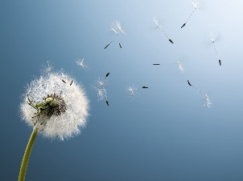
Practising self-leadership
‘The practice of intentionally influencing your thinking, feeling and actions towards your objectives’ (Bryant & Kazan, 2012)
Learning: having enthusiasm – self-leadership requires openness to new ideas, and is a lifelong process
Goals: setting, monitoring and correcting them as necessary – understanding that this process needs support from others at times
Letting go: learning where to direct your own energies, and where you might need to delegate to others – let others take responsibility!
Plans: having some schedules and sticking to them – thinking about making changes as a long-term project
Focus: doing one task well at one time – avoiding spreading yourself too thinly, and taking time to spend on single objectives
The Royal College of Midwives | www.rcm.org.uk
Notes:
So really when you’re thinking about practising self leadership if you take those 4 pillars it makes it sound likes it’s a very easy thing to do but of course in the process of our normal everyday lives its never that simple. There are always lots of other things going on but really that’s the beauty of this idea because self leadership is and should be a lifelong process, where we’ll have different pressures and responsibilities at different times and these will shift at various points but the point is that if we have this idea of self leadership going on then we are always prepared for the next thing that comes along…. The quote at the top of the page from Bryant and Kazan who write a lot about self leadership and the idea that it is intentionally influencing, so really the idea is that you have control of your life if you enable yourself to take some control, of course there will always be things in our lives we can’t control but there is so much that we can.
So in summary:
Reflect and think about your values, what is your ‘bottom line’ in any situation. Examine this and then look at what is working and now working so well
Be open to feedback and train yourself to hear the positives, let go of your self criticism and negativity towards your ‘weaknesses’.
Take your own advice
Self leadership is a lifelong process not a task that we start and stop

Slide 6
Healthier Choices

Slide 7
NHS Health and Wellbeing Framework - NHS Employers
The Royal College of Midwives | www.rcm.org.uk
Notes:
Without staff that are well and at work, the NHS could not deliver quality and effective care to patients.
We need to ensure that staff are provided with an environment and opportunities that encourage and enable them to lead healthy lives and make choices that support their wellbeing.
It is more important than ever that NHS workplaces become environments that support staff to do this.
The Health and Wellbeing Framework sets out the standards for what NHS organisations need to do to support staff to feel well, healthy and happy at work. It sets out clear actionable steps and provides guidance for organisations to develop and deliver a staff health and wellbeing plan.

Slide 8
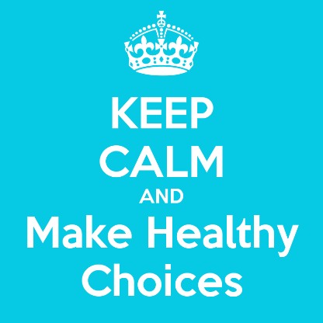
Healthier choices
ACTIVITY
The Royal College of Midwives | www.rcm.org.uk
Notes:
ACTIVITY
How often do you plan to exercise on your day off? – How often do you end up not doing this?
How often do you plan to eat healthy at work, only for it to fall apart when the tea trolley comes out?
Think about how you feel at the start and end of the day do you think your food choices affect this?
How do you switch off after a shift? It is with wine, chocolate or takeaways

Slide 9
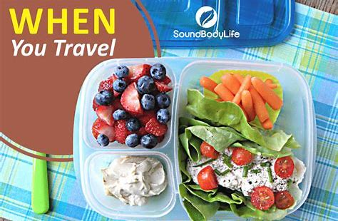
Healthier Choices
Part of having a healthier lifestyle is about choosing to adopt healthier habits when it comes to our food
Did you realise that what you eat can directly affect your mood
How to manage your mood with food | 8 tips – YouTube
Slimming World is one of the RCM’s Alliance partners
The Royal College of Midwives | www.rcm.org.uk
Notes:
This is not about loosing weight, we all know what we should and what we shouldn’t eat, this is about making the right choices, the healthier choices.
How to manage your mood with food | 8 tips - YouTube

Slide 10
How exercise can improve your wellbeing
Notes:
How to self motivate. What are your motivators? How you can motivate each other.

Slide 11
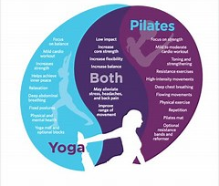
The Royal College of Midwives | www.rcm.org.uk
Notes:
Exercise isn’t all about spending hours doing cardio at the gym, this can be exercise of the mind as well as the body. Small movements throughout the day, even having a stretch can help our bodies to get moving, particularly if we have been sitting for a while.

Slide 12
The Benefits of Exercise
‘Exercise not only changes your body, it changes your mind, your attitude, and your mood’
Regular exercise will:
Reduce the risk of many long term chronic conditions (heart disease, type 2 diabetes, stroke and some cancers)
Support the building of strong muscles and bones
Help protect your memory and thinking skills
Strengthen your immune system
Improve sleep quality
Reduce pain
Make you feel happier
The Royal College of Midwives | www.rcm.org.uk
Notes:
So exercise as mentioned isn’t necessarily something just of the body but of the mind as the quote says and when you read through these bullet point most of them I’m sure are no surprise to you.
But as we are still very much in the middle of a pandemic I want to just pull one of them out. Strengthen your immune systems it may seem a strange one that excersie would do this but of course if you are a little run down because of extra shifts, home schooling and just general life pressures, of course it wont protect you from the virus but it could well protect you again any secondary infections that you may pick up as a consequence of contracting covid and it’s often these secondary infections that cause more long term problems.

Slide 13
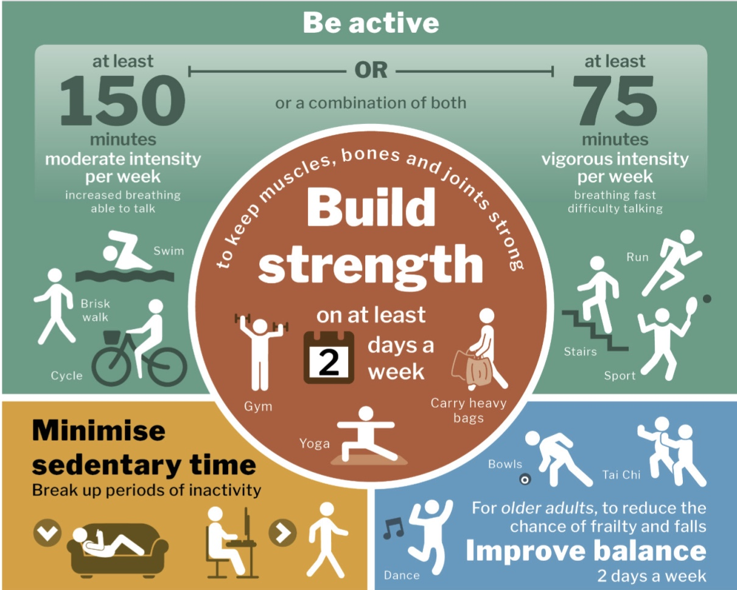
What is regular exercise?
The Royal College of Midwives | www.rcm.org.uk
Notes:
Some of you may be familiar with this poster, and you’re probably already aware that the UK government recommends 115 minutes of moderate or 75 minutes of vigorous exercise per week or UK adults, however we know that only about 50% of people actually achieve this and when we look at strength training where its recommended that at least 2 days a week are spent on this it drops to around 25% of all UK adults achieving this. It’s thought that people didn’t realise it was and AND not an either or, therefore the Government have now reversed their information and they are now putting strength training about aerobic exercise as it’s now recognised as being the most important for your overall lasting health. From the age of about 30 your muscle strength starts to decline and by the age of 70, it’s declined so much that it could affect your ability to live independently. If you think about it, you need muscle strength to do anything required to take care of yourself, washing, dressing, toileting, etc so if you are not able to do that because of lack of muscle strength then you cannot live on your own. So strength training is really important, especially as you get older. The other great thing about strength training it that it does burn calories, and it continues to burn calories after the fact as it raises your basal metabolic rate, whereby you're burning calories as your body ‘repairs’ your muscles.
However even if you do your strength training and aerobic exercise for the week but spend the majority of the rest of the time sitting then you have completely lost the benefit of that exercise. You may have heard the phrase that sitting is the new smoking and the research coming out now certainly backs this theory up. So do remain as active as you can.
NOTES: The UK Government now lists strength training before aerobic exercise. About 50% of the UK population get enough aerobic exercise but only 25% get enough strength exercise. The case for strength training is strong. Stronger muscles decreases the chance of getting heart disease, type 2 diabetes and cancer. It can improve your memory and prevent cognitive decline. Age related muscle loss starts around the age of 30 with 5% of muscle mass loss per decade. This accelerates at 70 years of age. The decline can be reduced or halted by strength training. Strength training can help regulate the body’s glucose levels. Strength training burns calories by raising the basal metabolic rate at rest.

Slide 14
Exercise during a Pandemic
If you are not self isolating go outdoors for a walk, run or cycle.
Walk fast enough to raise your heart rate and feel slightly out of breath.
Gardening or tending an allotment will raise your heart rate. Digging and lifting will improve your strength.
Take advantage of the numerous virtual workouts now on offer.
If you belong to a gym check out if they are offering virtual workouts.
Body strength exercises can be as beneficial as using weights.
Yoga is a strength exercise. It may also help to calm any anxiety you may have.
Stay Safe Stay Healthy
The Royal College of Midwives | www.rcm.org.uk
Notes:
While we are all still in lockdown there are ways to get your activity in, particularly if you are now WFH, or shielding where you are more used to being active all day. You can see a list here of suggested ideas for either during or out of lockdown! You could always try getting a friend involved to!

Slide 15
Mental Health First Aid

Slide 16
Mental Health at Work
The UK Whelm study (2018) found that midwives report burnout and compassion fatigue.
Factors associated with high levels of burnout, depression, anxiety and stress.
Younger midwives (midwives aged 40 and below)
Midwives with a disability
Midwives with less than 30 years’ experience
Clinical midwives, particularly those working rotation in hospital and in integrated hospital/community settings.
Perceptions of low levels of resource adequacy was the strongest predictor of work related burnout
Perceived low levels of management support, professional recognition and opportunities for development also contributed to burnout, depression, anxiety and stress.
The Royal College of Midwives | www.rcm.org.uk
Notes:
Don’t have to share any experiences if you don’t wish to.
One group to discuss pressures inside of work.
One group to discuss pressures outside of work.
Feedback
Then get into groups and discuss possible solutions to issues then feedback.

Slide 17
The Royal College of Midwives | www.rcm.org.uk

Slide 18
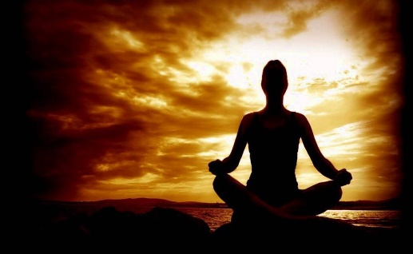
The Royal College of Midwives | www.rcm.org.uk
Notes:
Meditation can appear to be one of those buzz words that gets banded about, along with self-care and resilience and yet the concept of it can seem unknown. Meditation doesn’t mean you have to sit in an uncomfortable yoga position with incense burning, it is the practice of allowing yourself and giving yourself time. Time to focus on yourself, your body, your feelings and it’s a way of connecting with yourself without outside influences.
Effective meditation doesn’t and shouldn’t take a lot of effort, breathing techniques are one type of meditation and can be a really effective and quick way of calming our minds, particularly if we are feeling anxious or stressed. And I’m sure a lot of you feel anxious or overwhelmed at least at one point on a shift in our every day lives. We want to engage that parasympathetic nervous system and breathing techniques can help with this.

Slide 19
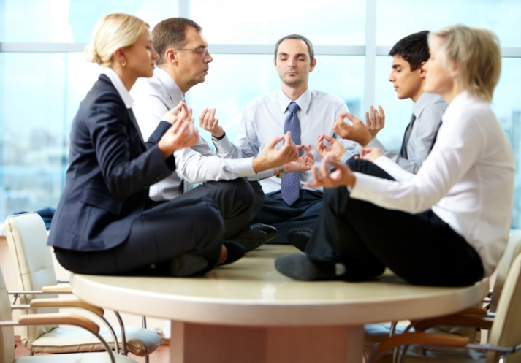
The Royal College of Midwives | www.rcm.org.uk
Notes:
Being mindful or mindfulness is just a state of being, it doesn’t take any work, its about just being present in the task that you are doing, so reading a book and focusing entirely on that, playing with the kids and not being distracted by your phone or that moment when you are truly with woman and your thoughts are nowhere else.
Gratitude Jar is a simple way of allowing your colleagues to feel appreciated.
Fill a Jar with quotes, sayings or affirmations, let people add to this as they wish (although nothing personal), leave it in an accessible yet somewhat private space so people can have a moment to themselves if needed. Encourage people to lucky dip as they need throughout the shift to hopefully help give them a boost. Ideas include:
Remember to just breathe
You are enough
You can only ever do your best
You are beautiful
Thank you for being here
We all appreciate you
Smile, it lights up your eyes
As a take away I have a list to help you get started, you can print off from home.
At the end of your day close your eyes and state 3 things to yourself that you are grateful for, repeat them 3 times while taking deep breaths, then say thank you to yourself 3 times

Slide 20
Breathing Technique Activity
If you choose not to take part please be very still over the next few minutes so your colleagues can get the most out of this that they can.
How do you feel now, do you feel more relaxed than you did? Do you feel a sense of calm or peace?
This simple breathing technique called counting breath can really help feelings of feeling anxiousness, overwhelmed or stress. By encouraging you to focus on counting the breaths it is designed to allow your mind to rest so that once your awareness is back in the room your thought patterns can be more clear and your focus will have returned.
Other thoughts may enter your mind while you do this (this is very normal) but the trick is to not follow them and to allow it to drift away. You will get better at this with practice!
Counting Breath Meditation (4mins)
The Royal College of Midwives | www.rcm.org.uk
Notes:
Starting off with a new activity can always seem dauting so we are going to do a little activity now. A simple breathing exercise.
If you can sit comfortably in a chair with a straightened back, put both feet on the floor, lower your chin slightly so your neck is not extended and if you feel comfortable gently close your eyes, or lower your gaze to the floor. Take a moment to think about how you are feeling right now, this could be sad, happy, bored, whatever.
Place one hand over your heart, either hand doesn’t matter, and the other over your stomach. And just breathe, listen to your breath, feel the movement of your hands as your lungs expand and compress.
Take a big breath in through your nose, feel your hands moving as you inhale, take a breath all the way down to your stomach and feel that hand rise, then sigh out your breath through your mouth. I want you to do this in your own time 3 more times.
Return your breathing to normal, this time as you inhale I want you to think of the number 1 and as you breathe out through your nose also the number one, the next breath in think of the number 2 and as you breathe out think of the number 2, do this in your own time until you reach 10.
Once you’ve reached 10 start to bring your awareness back to the room, wriggle your fingers, have a stretch or a yawn whatever feels natural.

Slide 21
ACTIVITY
The Royal College of Midwives | www.rcm.org.uk
Notes:
ACTIVITY
Draw around your hand – add one thing to each finger that you have either learnt or decided to take on following this presentation, remember it doesn't have to be big, something small and achievable.
If you feel comfortable, tell us something that you’ve written

Slide 22
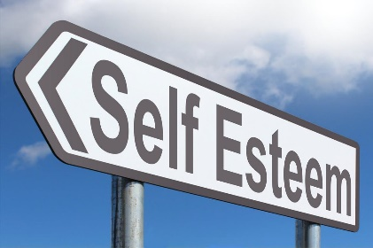
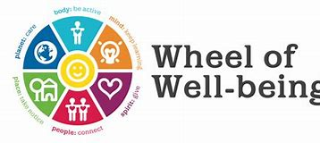
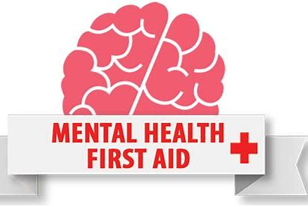
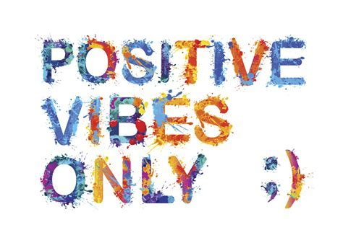
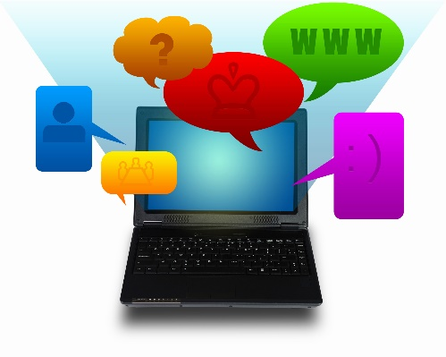
Workshops and new presentations
The Royal College of Midwives | www.rcm.org.uk
Notes:
Working with the menopause
Social media workshop
Statement writing workshop
Wellbeing workshop
Mental health first aid
Positive cultures workshop
Confidence Building and
Digital Communications

Slide 23
For further information:
Website: www.rcm.org.uk Telephone: 0300 303 0444 Email: info@rcm.org.uk
www.facebook.com/midwivesRCM @MidwivesRCM midwives_RCM

