Slide 1
Invisible Cultures

Slide 2
ITEMS YOU WILL NEED FOR WORKSHOP
Post it notes
A box to collect concerns
Flip chart paper
Groupwork suggestions will be in the notes sections on the slides.
Before you start the session get them to write down on post it notes any issues that they are currently facing or behaviours that they see regularly in the workplace (that have become commonplace in the workplace).
At the start you can do the wellbeing 5 relaxation if you wish.

Slide 3
The Power of Culture
Organisational culture is the ‘personality’ of the organisation. It is comprised of assumptions, values, norms and tangible behaviours that are accepted and encouraged.
An unsupportive culture often underpins major problems faced by organisations and can lead to the acceptance of inappropriate behaviour, the failure to hold people accountable and the deterioration in teamwork and cross functional working.
Notes:
Get them to think about the unit’s philosophy and culture – is the mission statement reflected in day to day activities?
Is there a culture of openness where all views are considered?

Slide 4

Undermining behaviour in the NHS
The “silent epidemic "of the NHS
Affecting a quarter of staff in largest employer in Europe (Kline 2013)
Losing 10million working days in UK yearly
Reported in NHS staff survey 2016 & GMC annual survey on doctors in training
A longstanding and serious problem for maternity services across UK
Raised consistently by Health Service unions
Issue that has been going on for many years
That no one wants to talk about!
Notes:
C&H 19% Midwives reported B&H in NHS Staff Survey 2016

Slide 5

2016 NHS Staff Survey
Across Acute Trusts 25 per cent of those who responded reported that they have experienced harassment or bullying in the last 12 months.
45 per cent reported that this experience was recent.
29.9 per cent of all NHS staff indicated experience of psychological distress due to bullying behaviours
80 per cent of staff believe the state of their health affects patient care
Notes:
Discuss answers on the post it notes as a large group. Then get them to discuss in groups how this affects their (or colleagues) physical or mental health.

Slide 6




Midwives Responses
Of the Midwives who responded to the NHS Staff survey
18 per cent reported bullying by a manager
22 per cent reported bullying by other colleagues
53 per cent didn’t report it.
Notes:
Very worrying that 53% of those who reported B&H DID NOT report it.

Slide 7

Who is Undermining and where?
Maternity services have worst findings of GMC cases
Obstetrics and gynaecology theatres next
Trainee doctors by seniors and consultants
Trainee doctors by MWs
MWs by MWs
MWs by managers, team leaders and doctors
Notes:
Limited evidence as to why particularly in Midwifery?
Could be Medical Dominance from the middle ages-MW response to this?
Three common contexts-Bully wants to comouflage their underperformance, Bully is worried they are failing, Bully feels their target is better than them.
Culture occurs when these behaviours become accepted.

Slide 8
What does it look like
Negative and non constructive feedback
Disagreement on action plans in front of patients
Criticism of skills in front of others
Public “telling off”
Unwelcoming
Harassment- including sexual
Spreading rumours
Exclusion
Threatening-emotional or physical

Slide 9
The Bullying Cycle
Perpetrator uses aggressive intimidating behaviour towards individual
Victim feels afraid and unable to cope or report
Perpetrator learns their use of aggression works with victim and gives them feeling of well-being and control
As victim complies bully learns this works and continues behaviour - the cycle continues

Slide 10


The Impact of a negative Culture
Low Organisational satisfaction
Low job satisfaction
High staff turnover
High levels of sickness-impact on psychological and physical health.
A culture of blame and punishment
Mid-Staffordshire NHS Trust Francis 2013 -a culture of fear and speaking out “bullying was a key driver of the toxic culture.”
Extremely poor working relationships between different groups of staff-Kirkup 2015
Negative affect on care to women.
Potential harm to the midwifery profession.
Notes:
Poor relationships was a major issue. Kirkup described this as tribal working – where professionals didn’t communicate effectively with each other. There were professional disagreements which went unchecked.
Women whose status changed were not referred to obstetricians and there were arguments between obstetricians and anaesthetist,
There was a culture of not asking for help or advise and there were “groups” of midwives who were hard to work with.
Article in Midwives Juliette Astrup-Bullying the writing’s on the wall. Winter 2015

Slide 11
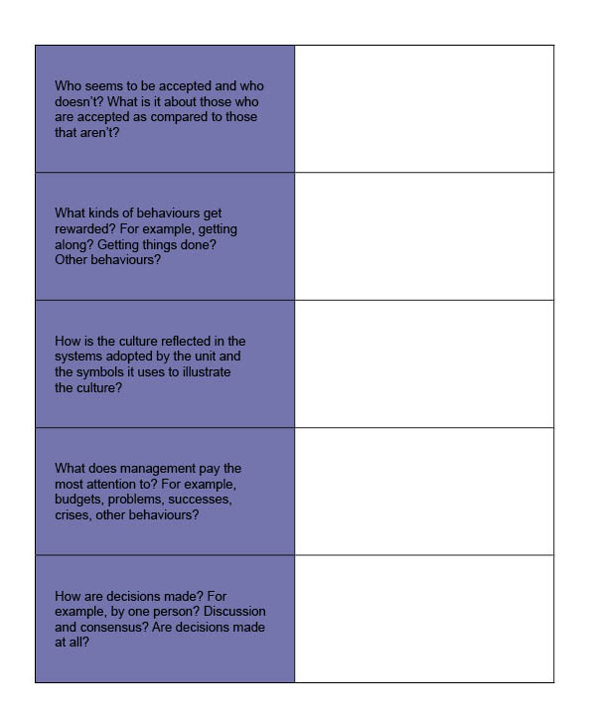
Your Unit
Using this template describe the culture of your unit.
Consider what you see and hear, not what you feel and think.
Notes:
Put them into small groups and ask them these questions, take about 3-4 minutes for each one – then get to hear back from them.
Are all levels saying the same thing or does hierarchy and or experience make a difference?

Slide 12
Change the Culture
To effectively shift culture you must influence people by positively demonstrating the actions and behaviours that will develop thinking and beliefs that underpin the “way things are done around here”
Achieving a shift in the way people act requires a clear understanding, supported by evidence of what you expect people to start doing and continue doing. Just telling people what they must do, and not providing role-model behaviour is not sufficient to create and enabling culture.
Notes:
In groups discuss what changes you can make to influence change of culture in the workplace.

Slide 13
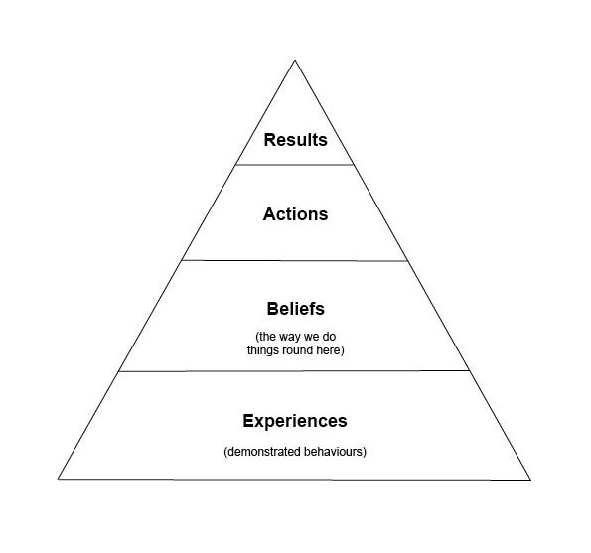
Change the culture
For the desired results to be delivered in your Unit, what do people need to do; what do they have to believe and most importantly how can you as a leader create the experiences they need to both believe and act in the right way?
Notes:
People respond to their experiences and that is seen as their “norm”
For example if you experience a workplace where staff are not listened to, then it becomes their belief that that is how it is, their actions relate to their experiences and beliefs and the result is that the person doesn’t challenge, ask questions or offer advice.
However, if the experience is supportive, encouraging etc then the belief will be that this is a positive environment, actions will follow and the results will be positive and supportive. Midwives know this when they are caring for women but do not necessarily recognise it when they think about their workplace.
However, it is everyone’s responsibility to ensure that the culture presents a positive experience. Misery and moaning is very contagious.
Relate an example of something that’s been accepted as the norm/what everybody believes the way things are done. Breaks a good example-accepted that non taken-never allocated. Or conversley same staff allocated and others not.

Slide 14
What is it like where you work??
How often do you hear……..?
You’re a qualified midwife now-why are you asking me?-you make the decision.
I don’t care if you haven’t got a bed, the labour ward is really busy – I’m bringing her over, you’ll have to sort it
What?? Another transfer from MLU you can’t manage??? They’re hopeless over there they don’t know what they’re doing!
Oh - that’s just her you’ll get used to it.
Notes:
Add local quotes here Think about quotes that you have heard.

Slide 15
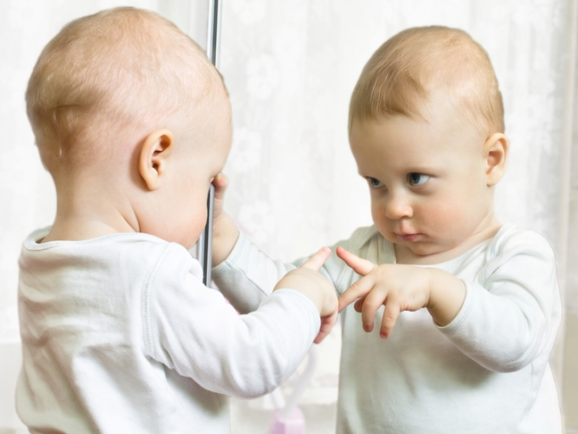

Your Responsibility
How do your colleagues see you?
Do you see what other people are seeing?
Could you be accused of being a bully?
Notes:
Take a minute to reflect on this slide. How do your colleagues see you?

Slide 16
Your Responsibility
Know yourself & the impact you have on others
  Practice how to disagree without undermining
  Don’t plan your rebuttal while the other person is talking!
Ensure all views are taken into account
  Explore with rather than argue against
  Listen carefully and seek to understand
Do not walk by when you see it happening
Have courage to help and report it
If you don’t intervene the cycle will continue
Notes:
Task group work.

Slide 17



Zero Tolerance
Statement of Commitment
The RCM and RCOG together categorically condemn undermining and bullying behaviour under any circumstances.
Together we will promote a positive working environment for all, where individuals and teams treat each other with compassion, dignity and respect, where critical feedback and whistleblowing are encouraged, and women are central to the care we provide.
A culture in which unsafe care is reported by any member of staff, independent of their seniority will be nurtured and supported.
Tackling Bullying in the NHS - A collective call to action
• achieve the overarching leadership and cultural change to tackle bullying
• support staff to respectfully challenge problem behaviours
• publish their plans and progress so staff, patients and the public can hold them to account.
Notes:
Action from
Actions from National SPF
For all NHS organisations to undertake preparatory actions then make a pledge for how they will tackle Bullying in their organisations.
• To achieve measurable change at national level by 2020.

Slide 18
CQC response

Slide 20




The way Forwards
Know and adhere to your Trust Values
Remember your NMC Code
Use your Trust Policies and Processes
Treat people the way you want to be treated
Talk to people the way you want to be talked to
Be brave-challenge and report
Use RCOG/RCM Toolkit https://www.rcog.org.uk/underminingtoolkit
RCM i-learn module
http://www.ilearn.rcm.org.uk/
Respect and be kind to each other
Notes:
Find Trust Values
Prioritise people-treat people with kindness and dignity-Practise Effectively-respect the skills and expertise of colleagues-work with colleagues-Promote professionalism and Trust-be aware of your behaviour-act as a role model for students.
HR Policies-dignity at work-Whistleblowing-Freedom to speak up guardian.
RCM rep

Slide 21


For further information
Website: www.rcm.org.uk
Telephone: 0300 303 0444
Email: info@rcm.org.uk
www.facebook.com/midwivesRCM
@MidwivesRCM

