Slide 1
Appraisal Workshop

Slide 2
Housekeeping
Introductions
Using Microsoft Teams
Virtual Meeting Rules

Slide 3
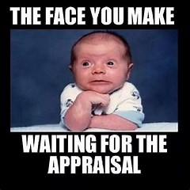
Learning outcomes
The case for appraisal
Essential preparation for your appraisal
What to expect during the appraisal meeting
Making the appraisal a partnership
Agreeing performance objectives
Personal development planning
What to expect after the appraisal meeting

Slide 4
Agenda for Change
The pay progression of NHS Staff employed on Agenda for Change terms and conditions is conditional upon them demonstrating that they have the knowledge and skills/competencies for their role.
The appraisal meeting will be used to assess their knowledge and skills/competencies against a profile for that pay increment.
In England employers, in agreement with NHS Trade Unions, can use an alternative competency framework. This is based upon the Knowledge and Skills Framework.

Slide 5
Groupwork using chat function
In the chat box, list as many reasons you can think of as to why appraisals are important.

Slide 6
NHS Knowledge & Skills Framework
The NHS Knowledge and Skills Framework (KSF) is a tool that is used to describe the knowledge and skills you need to apply at work in order to deliver high quality services and includes an annual system of review and development for all staff covered by Agenda for Change contracts. You will typically have annual development reviews against your KSF post outline that will result in the production of your personal development plan. Your line manager should work with you to agree development plans and then to enable you to fulfil what is in them. Your manager should encourage you to progress and develop and where training and/or development needs have been identified and agreed, they should ensure sufficient financial support is provided.

Slide 7
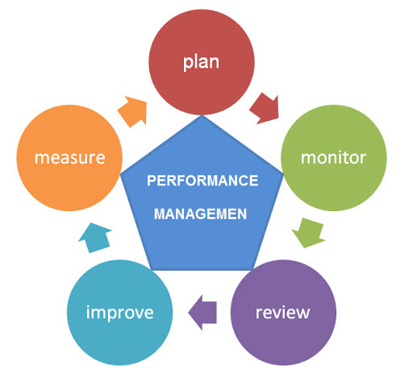
Appraisal Process
APPRAISAL

Slide 8
Comfort Break!

Slide 9
Benefits from a successful appraisal should include
Receiving recognition and support from management as you develop in your work role.
Being reminded of how you are contributing to the quality of service of your unit.
Having the opportunity to have your views and suggestions heard relating to both your own development and that of the overall unit.
Clearer understanding of organisational goals by all staff.
Stronger working relationships between the manager and staff.
Improved organisational productivity as a result of discussing individual performance issues.
Objectivity in decision making concerning promotions, training, and other personnel actions.

Slide 10
Questions to ask yourself before your appraisal
Do you have a clear understanding of your role and the part you play within the team and organisation?
Do you have an agreed set of priorities and objectives for your work?
Are you able to apply the knowledge and skills you need to perform that role effectively and to achieve your objectives?
Think back to your past experiences of undergoing an appraisal.
With the benefit of hindsight, what did you do to contribute to either the positive or negative experience? Were you an equal party to the appraisal or were you just the recipient of it?

Slide 11
Preparing for your meeting
You should have been given uninterrupted time for the meeting.
The meeting should be scheduled in advance to allow you the time to prepare.
Think of how you have performed since your last meeting and be ready with an answer to the question.
Enter the meeting with a positive mindset.
Gather your documentation.

Slide 12
What documentation do you think you need?
Notes:
Job Descriptions

Slide 13
Structure of the discussion
Initial discussion
Agreeing what the purpose of the meeting is and what you each hope to achieve. Sharing each other’s objectives with regard to the discussions.
Review of past year’s objectives/development plan/receiving feedback
Conducting a thorough review of your progress during the appraisal period
Objective setting
Following feedback and discussion, agreeing performance standards and objectives for the next year.
Personal Development Plan
Discussing development activities for you to undertake.
Summary
Reaching a conclusion on what has been discussed and what will happen next.

Slide 14
Appraisal discussion
This discussion should be based on:
Agreement on the type and level of knowledge and skill required to carry out your job successfully so that you achieve the agreed job objectives.
A mutual understanding of the levels of skill and knowledge you have actually displayed during the previous year.
An assessment of whether you have displayed the required levels of skills and knowledge demanded by your performance objectives in the next year.
Planning development actions such as training or work experience to address identified shortfalls or gaps in the required skills and knowledge.
Prioritising this development in terms of which is the most important e.g. mandatory training, development required for the job and training that you would value for your own personal development.
This discussion should not include any surprise concerns about your practice or conduct.

Slide 15
Comfort Break!

Slide 16
Receiving and responding to managers feedback
A good appraisal should be rich in feedback with an honest and direct discussion on areas of strength and areas where performance needs to improve. It is generally fair to say that very few people really enjoy receiving feedback - nobody likes being told what they are doing is wrong and controversially people are often equally uncomfortable when discussing areas where they did well. Feedback helps us to stop, think and learn how to do things differently so we remain effective in our role, focused on the right things and motivated to continue to develop our capabilities. It is important that the process of giving and receiving feedback is handled correctly. When handled badly, it can lead to frustration, anger and ill feeling between colleagues.
Please refer to your pre-course work and reflect on your previous experiences using the chat function.
How do you react to feedback whether it is positive or negative?

Slide 17
SMART objectives
To be SMART, objectives should be:
Specific
Clearly expressed in terms of the specific results you want to achieve. Making the objective measurable helps ensure that it is specific. (The activities needed to achieve the objective should also be agreed)
Measurable
You should be able to measure the attainment of the objective. Measures can be related to rate, frequency, number or percentage. What system is in place to track the progress towards attainment?
Achievable
The objective agreed must be capable of being completed successfully. Consider whether this can be done in the timeframe with the resources available?
Realistic/Resources
With the resources available (include money, skills, equipment, time) is it possible to achieve this objective?
Timed
An achievable and realistic deadline is required to measure achievement of the objective
Use ifolio to plan your objectives for next year and how you can achieve these objectives.

Slide 18
Review the appraisal itself
To what extent where my objectives and outcomes for the appraisal met?
What worked well in the appraisal discussion and contributed to its success?
What would have made it easier or even better?
What did not work well and I should look to avoid in future?
What are the key points I have learned from this interview to help me improve the next one?

Slide 19
Following your appraisal
Following your meeting, you should be given access to a copy of your appraisal documentation.
Following your appraisal, if you are unhappy or confused, ask to speak to your manager again to clarify.
The appraisal process is literally that – a process. To be effective, it should not be a matter of holding an appraisal meeting and then doing nothing more for 12 months. There needs to be a continuing thread between the two events so that you can demonstrate continuing achievements that can be recognised.

Slide 20
Personal Development Plan
Your appraisal is an excellent opportunity to develop skills.
An employee who is willing to take even seemingly short-term steps towards investing in their personal development will reap the rewards longer term in their future career.
Finally, remember that appraisals are an ongoing process. Keep a record of things you have done and projects you have worked on throughout the year so that you can review these and have it to hand for your next appraisal. i-folio provides a great opportunity to efficiently keep all your records and reflection in one place.

Slide 21
Resources
NHS Empolyers NHS Key Skills Framework and Appraisals
https://www.nhsemployers.org/your-workforce/retain-and-improve/appraisals
RCM ilearn, ifolio and Career Framework
https://www.ilearn.rcm.org.uk/
Apprenticeships
https://www.rcm.org.uk/promoting/learning-careers/apprenticeships/

Slide 22
For further information
Website: www.rcm.org.uk
Telephone: 0300 303 0444
Email: info@rcm.org.uk
www.facebook.com/midwivesRCM
@MidwivesRCM

