Slide 1
Social Media and Networking
May 2020
Notes:
The aim of the session.
Understanding of the different social media platforms and how they differ
Making the most of the opportunities that social media networking can bring
Ensuring that you network safely online and understand the importance of protecting your information
Managing the boundaries between personal activity and professional activity on social media
Understanding your professional obligations and being aware of your employer's policies on the use of IT and social media
Some of this content is taken from the RCM i-learn course.

Slide 2
Learning outcomes
Understanding of the different social media platforms and how they differ
Making the most of the opportunities that social media networking can bring
Ensuring that you network safely online and understand the importance of protecting your information
Managing the boundaries between personal activity and professional activity on social media
Understanding your professional obligations and being aware of your employer's policies on the use of IT and social media
Understanding the role of an RCM workplace rep where policies are breached

Slide 3
Social Media
On the whole, social media has made it easier to learn about the world, its opportunities and the changes we are facing in every respect.
Technology and social media are making a positive difference in poorer countries, for example, with more information available to promote better health.
Most importantly it is easy to forget that once a user has added something online it may be there for all to see across the internet for years to come.
It is best to bear in mind that nothing is private once it is posted online. Even if you are very aware of privacy issues, online postings can be shared and passed on to much wider circles of people without your knowledge or permission. What you might have thought was a private posting only available to a small circle of friends can soon be shared with a much wider audience.

Slide 4
What is Social Media
Communication in all directions at any time, by any possible digital means
Online technologies and practices that people use to share content, opinions, insights, experiences, perspectives, and media themselves. They are media for social interaction.
Digital content and interaction that is created by and between people.
A new marketing tool that allows you to get to know
your customers and prospects in ways that were previously not
possible.
Notes:
Ask learners whilst in groups to give their definition of social media.
Here are just 4 definitions
1 = all encompassing definition
2 and 3 = emphasises that it’s all about content individuals create and share
4 = highlights that it is increasing seen as an advertising and marketing tool

Slide 5
Main types of Social Media
Social Networks
platforms that connect people and allow them to engage
Facebook, Twitter LinkedIn, Whatts App
Micro Blogs
short posts
Twitter
Blogs
easy to update page where authors regularly update in a diary format-via differing platforms
Media Sharing
Short videos or photographs used to communicate information
Youtube, Instagram, Snapchat, Filckr, Tik tok
Podcasts
audio files- Itunes
Discussion forums
places for online communities to discuss topics
Wikis
a collection of webpages that encourages users to contribute to the content.
Notes:
Interactive session
Ask audience to name the different types of social media.
Most will come up with FaceBook and Twitter, occassionally YouTube or Linked in. These are organisations rather than ‘types’ of social media
Social medial examples:
Instagram
Facebook
Messenger
Twitter
Vlog and blog.

Slide 6


Types of social media

Slide 7
RCM & Social Media
Many organisations now use social media to encourage wider engagement with products or services, to build campaigns, promote collaboration and get feedback from a wider audience including employers, employees and service users or consumers.
The RCM has a Facebook page, Instagram and Twitter feeds. Promoting the RCM via social media results in millions of 'impressions' (a user viewing, interacting or sharing a post). For example #MSWWeek and #IDM2020 built up millions of impressions on Twitter.
Almost every Trust or Health Board and Universities have social media pages as do most Midwifery Societies and local RCM branches. Staff Facebook pages to request shift changes are not uncommon. MVP’s and LMS’s are also active with groups of their own.
See the latest information from RCM:
Instagram: midwives_rcm
Twitter: @MidwivesRCM
Facebook: The Royal College of Midwives

Slide 8
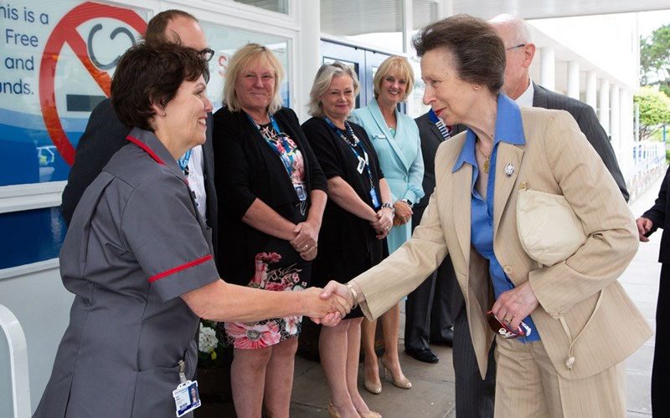
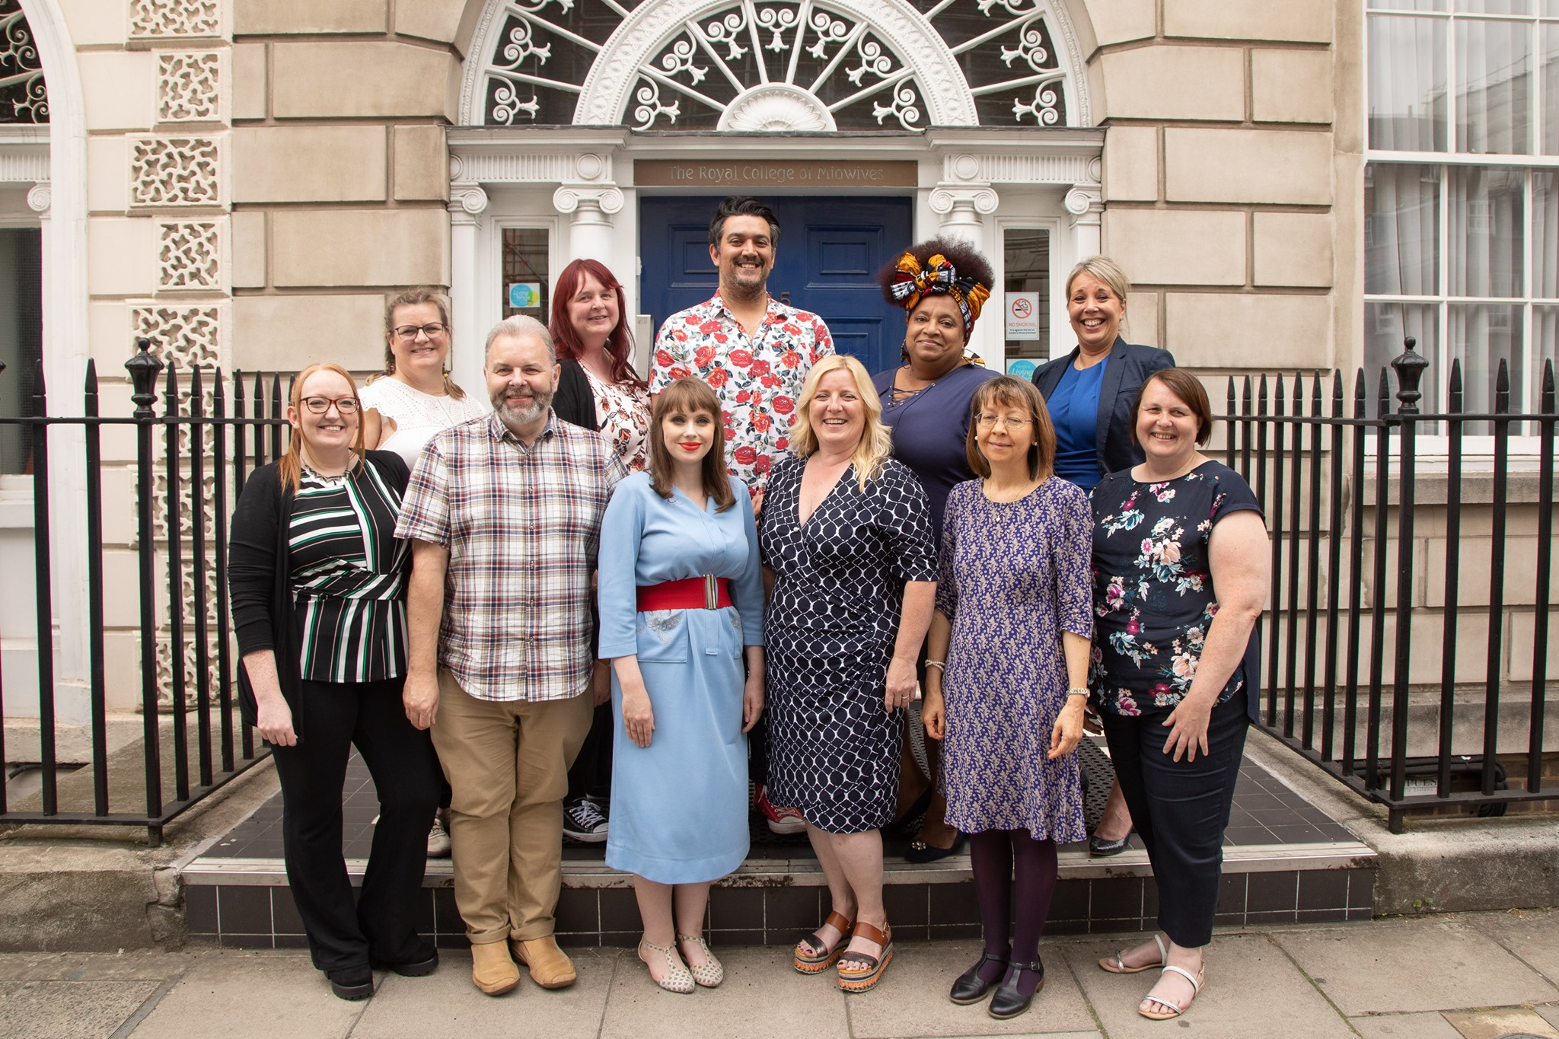
Positive social media
HRH visits The Princess Alexandra Maternity Wing in The Royal Cornwall Hospital for royal recognition. 4th August 2019
The New RCM board members 30thJuly 19

Slide 9
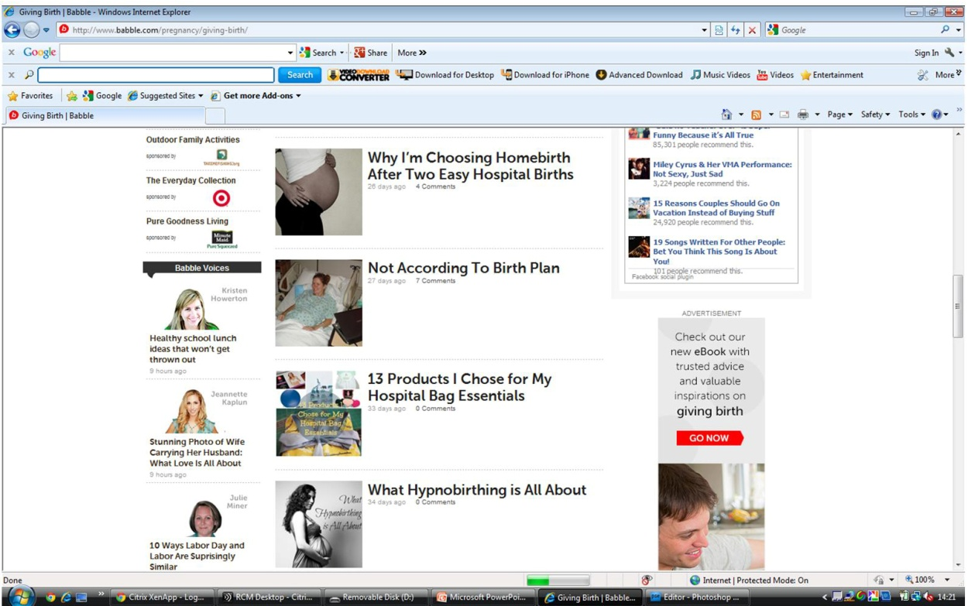
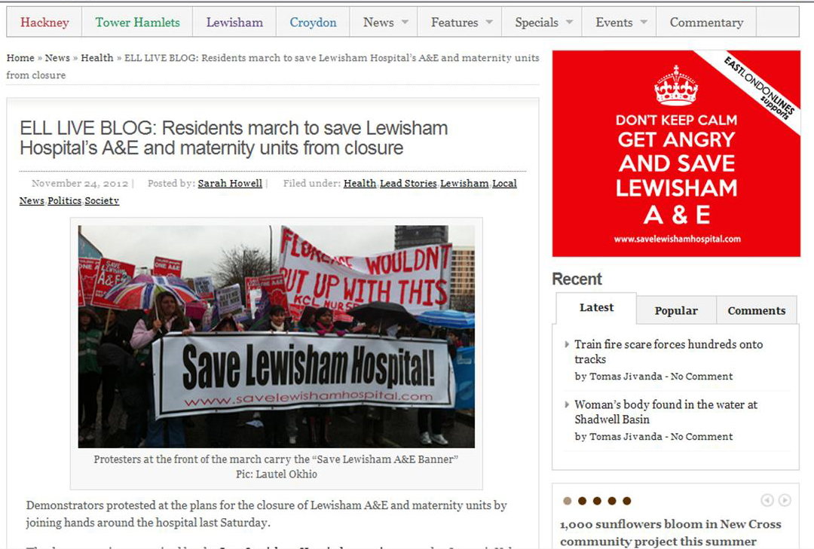
Social Media – Used for good
Notes:
More examples of social media and midwifery
A social networking site, sharing information, advice and experiences
A local campaign to keep Lewisham A&E and Maternity units open

Slide 10


Benefits
Keeping in touch with your existing friends
Making new friends
Join social groups of people with a common interest
Join professional groups of people with a common interest
Campaigning
Sharing information, images or videos
Collaboration or projects
Commercial marketing, advertising
Notes:
Discussion Group work with flipchart List the benefits of social media
Awareness
Staying connected
Campaigning
Sharing information
Tell me the benefits of Social Media use
Click at end to reveal some of the benefits we have identified

Slide 11

Social media gone wrong
Nurses sacked after posting pictures of themselves online wearing incontinence pads and tweet patients' personal details
The women joked publicly online about being too hungover to work
One woman said she nearly vomited while doing CPR on a patient
Another recommended taking hospital painkillers to deal with it

Slide 12
Social media gone wrong
One in 10 job seekers between the ages of 16 and 34 have been rejected for a job because of something posted on their profiles, according to a recent survey from London-based mobile research.
Nurse struck off after posting expletive-laden Facebook comments
A FOUL-MOUTHED nurse has been struck off after posting a spate of four-letter comments on Facebook - wrongly thinking her account was private.
Notes:
Remember screen shots can be taken of Facebook posts and shared with managers in your Trust.
2018 The Times reported that following a FOI request 1,200 employees had been disciplined about social media posts.
BMJ reported that in 2017 the GMC reviewed 28 doctors use of social media – Facebook, Twitter and Whatsapp

Slide 13
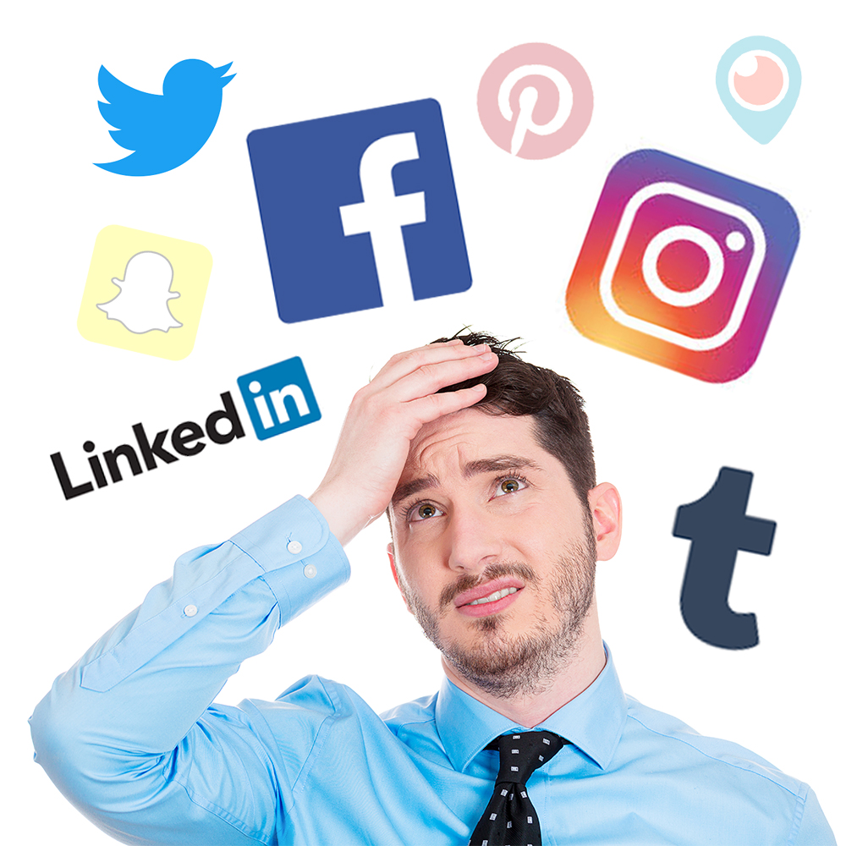



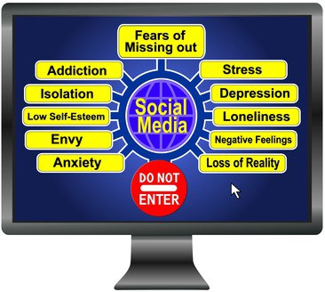

How does it affect you?
Notes:
Get the members to say how they feel using social media.
Frightened
Confused
Exasperated
Confident
Inspired
Included
Sense of purpose
Ask who uses it and in what way
Social media (networking) sites are websites and apps that allow people to connect with others who have similar interests. Users share information, thoughts, ideas and images and connect with family, friends, work colleagues or like-minded people.
Some sites such as Facebook, Twitter, Google+ and LinkedIn are based around making connections with people that you may know. Others such as Instagram, Flickr and YouTube are based around sharing images and video, whilst others like Blogger or Tumblr are about sharing a web log or online diary (blogging).

Slide 14
Case studies
Midwife A complains on Facebook that a woman she looked after during her previous shift was so overweight it’s a wonder the bed didn’t collapse. She then goes on to say "Why do we have to look after fat birds?"
Midwife B answers "I know exactly what you mean. Makes our job even harder!“
Outcome
In this case both midwives were taken through disciplinary procedures and dismissed for bringing the trust into disrepute.
A group of midwives were chatting on Facebook. All joined in a conversation complaining about where they work but all felt they were in a safe environment as they had set up a closed group for themselves. However someone outside their immediate circle had requested access to the group and this had been granted by the group administrator. She took screen shots of the comments, printed them out and put them under the head of midwifery’s door.
Outcome.
all midwives involved were disciplined and all received a final written warning. The two band 7s involved in this case were down-banded.
Notes:
Discuss the role of the RCM rep through disciplinary processes in relation to these cases.

Slide 15
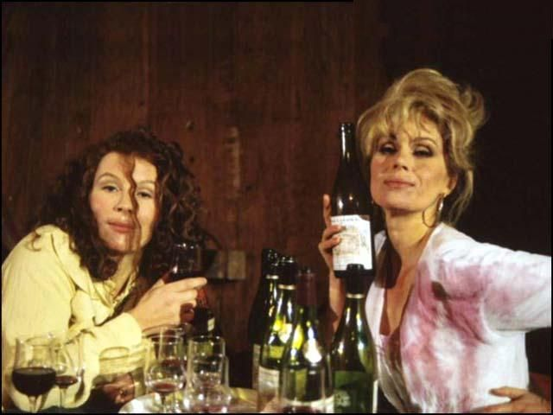
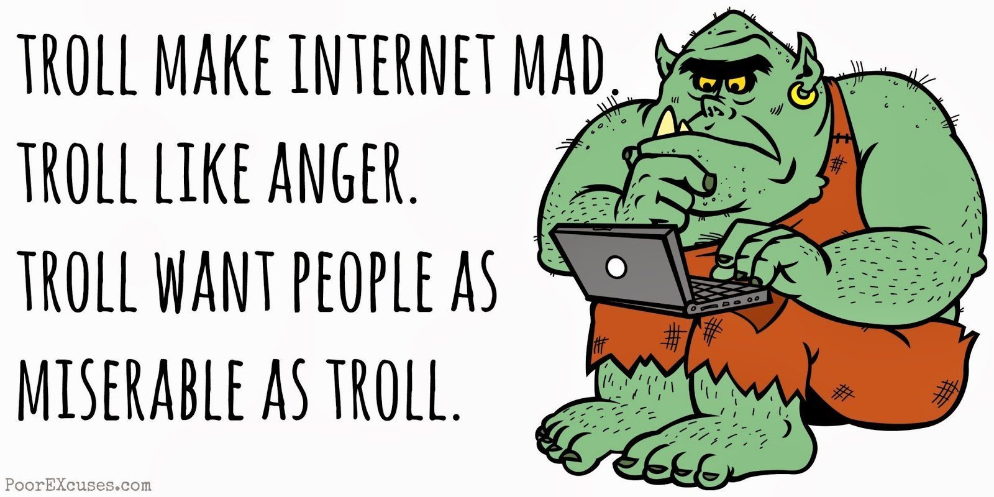


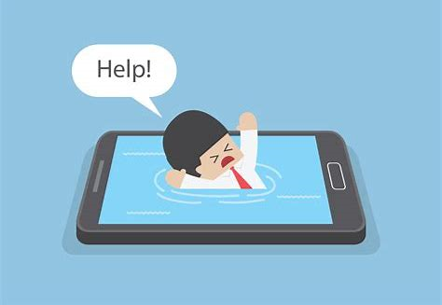

Disadvantages
What YOU post online..............
Notes:
Discussion Group work with flipchart-
Tell me the disadvantages of Social Media use
Cyberbullying
Hacking
Professional reputation-NHS worker-identifiable to others even if profile doesn’t say.
Addiction
Security issues
Lack of inhibition
What you post online is there forever.

Slide 16
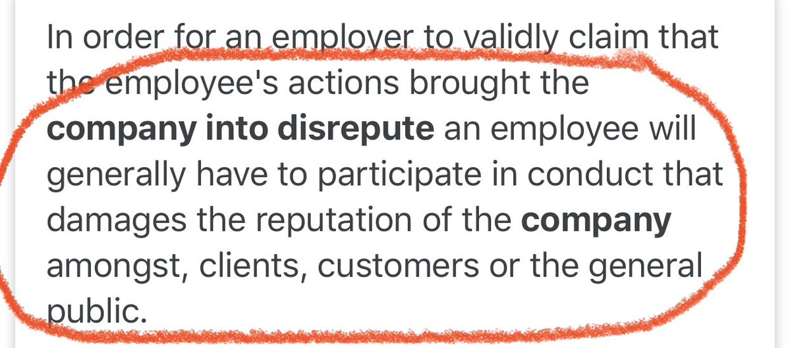


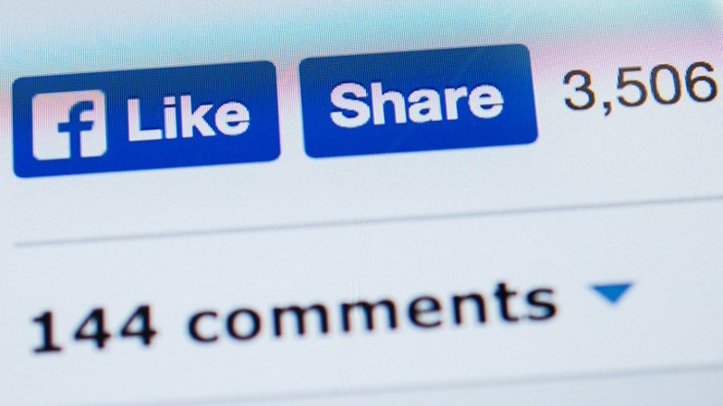

What your employer might say?
Bring the organisation into disrepute
Breach confidentiality
Breach copyright
Do anything that could be considered discriminatory against, or bullying or harassment of, any individual
Notes:
Bringing the organisation into disrepute.
criticising or arguing with customers, colleagues or rivals
making defamatory comments about individuals or other organisations or groups
posting images that are inappropriate or links to inappropriate content
Breach confidentiality
revealing trade secrets or information owned by the organisation giving away confidential information about an individual (such as a colleague or customer contact) or organisation (such as a rival business)
discussing the organisation's internal workings (such as deals that it is doing or future business plans that have not been communicated to the public).
Breach copywrite
using someone else's images or written content without permission
failing to give acknowledgement where permission has been given to reproduce something
Do anything that could be considerered discriminatory against, or bullying or harassment of, any individual
making offensive or derogatory comments relating to sex, gender reassignment, race (including nationality), disability, sexual orientation, religion or belief or age
using social media to bully another individual (such as an employee of the organisation)
posting images that are discriminatory or offensive [or links to such content]

Slide 17
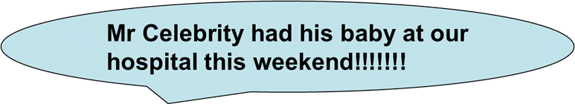
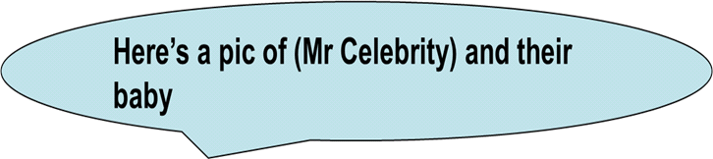
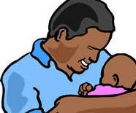
Consider this
Internal disciplinary action. Let off with a warning
Notes:
This did actually happen and the midwife got disciplined
Celebrity not unduly concerned – all publicity = good publicity

Slide 18
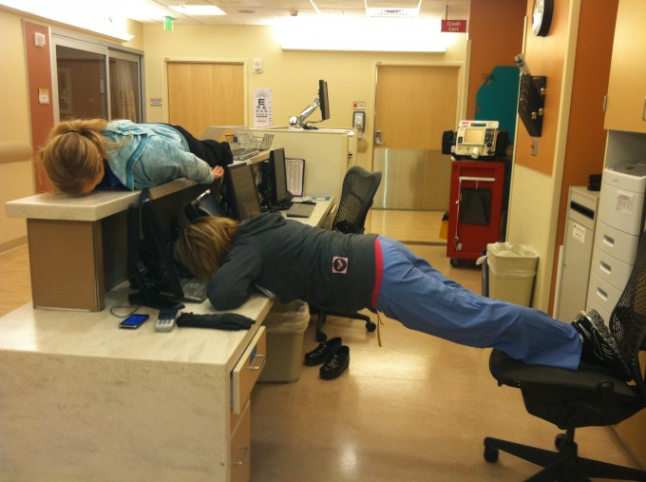
Consider this
All three suspended and given written warnings
Notes:
Ever heard of ‘planking’?
Staff larking around and the photo got re-sent among colleagues and sent to manager.
Suspended, disciplined but didn’t lose their jobs. Very traumatic and upsetting experience

Slide 19
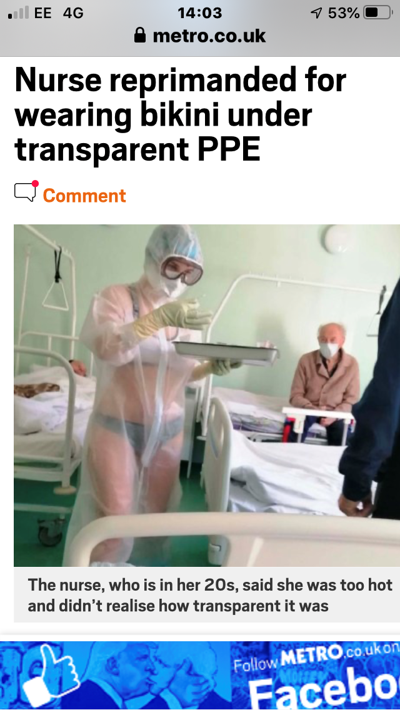

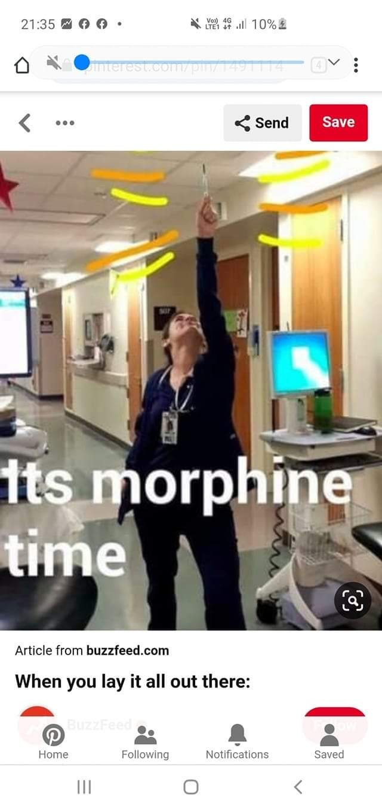
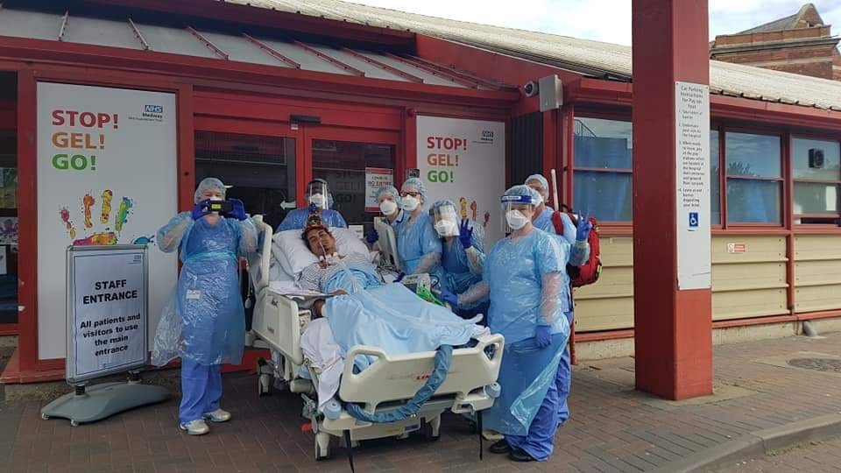
What do you think of these?
Notes:
The recent Covid outbreak has led to a flurry of photos on social media-but are they all giving out the right message?
A&E staff at Southend hospital in Essex have been warned that they could face disciplinary action if they raise the issue of PPE publicly during the CoVid -19 Pandemic.
In a memo on 26 March 2020 they were told: “The posting of inappropriate social media commentary or the posting of photographs of staff in uniform who are not complying with IPC [infection prevention and control] standards and social distancing requirements is unacceptable. Such behaviour will be considered under the disciplinary policy.

Slide 20
Suitable to share online?
Busy shift, couldn’t get away on time at the end of it, why is it always so difficult…..
Look out night shift on Labour Ward understaffed AGAIN! You girls are going to be sooo busy…..
Notes:
Ask is these are suitable – the first may seem fine, the choice of words ‘busy shift’ and ‘difficult’ seem just a personal comment on a days work but lots of things may have occurred on that shift (in this case a neo natal death) and although this person was not involved in that care it was seen to bring the Trust into disrepute.
What if a pregnant woman got to see the second Tweet? ‘Labour Ward understaffed’ comment may cause worries, concerns, anxiety etc.

Slide 21
Requests from women and their partners
What do you do if asked to ‘Be my FaceBook friend’ or ‘Follow me on Twitter’?
How do you respond to requests for photographs?
Notes:
Start group discussion
FaceBook and Twitter – suggest the members politely decline – ‘breaks Trust and NMC guidelines’ is a good get-out.
Interactions can be shared with anyone, may breach patient confidentiality
Photographs – you have the right to decline to be photographed. You have no idea how or where the pictures will be used.
Discussion – it can be hard to decline an invitation to be photographed, especially if the member of staff has built up a great rapport with the woman.

Slide 22
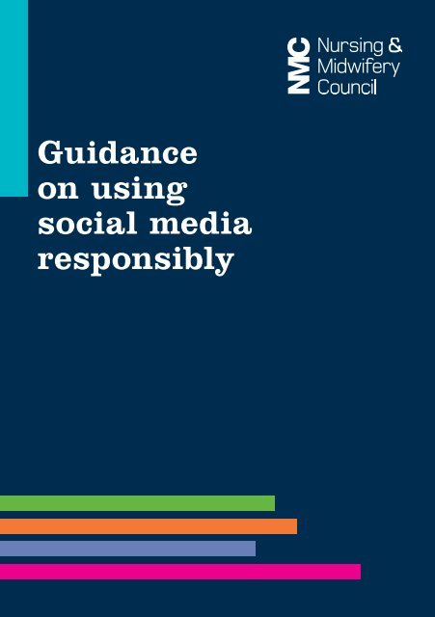
NMC and Social Media
Nurses and midwives may put their registration at risk, and students may jeopardise their ability to join our register, if they act in any way that is unprofessional or unlawful on social media including (but not limited to):
Sharing confidential information inappropriately;
Posting pictures of patients and people receiving care without their consent;
Posting inappropriate comments about patients;
Building or pursuing relationships with patients or service users;
Bullying, intimidating or exploiting people
Stealing personal information or using someone else’s identity;
Encouraging violence or self-harm; and
Inciting hatred or discrimination.
Notes:
Emphasise Midwives can put their registration ( and therefore their jobs and livelihood) at risk
Students too can jeopardise their chances over ever getting on the register

Slide 23
NMC guidance
If used responsibly and appropriately, social networking sites can offer several benefits for nurses, midwives and students. These include:
building and maintaining professional relationships;
establishing or accessing nursing and midwifery support networks and being able to discuss specific issues, interests, research and clinical experiences with other healthcare professionals globally; and
being able to access resources for continuing professional development (CPD).
NMC ‘Guidance on Using Social Media Responsibly’ March 2015
Notes:
NMC Guidance (March 2015) states that they promote the beneficial aspects of Social Media.

Slide 24

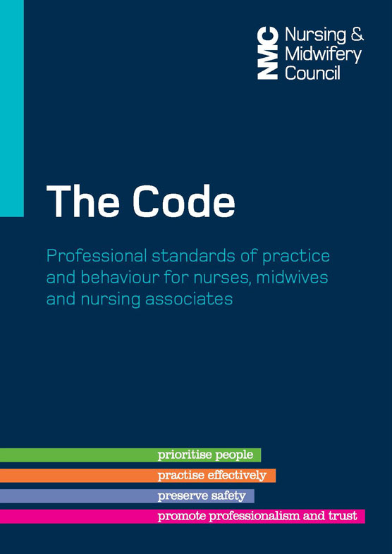

Think Safety
Check your social media privacy settings
Adhere to Professional standards
Familiarise Yourself with local Trust Policy

Slide 25

Social Media

Slide 26


For further information
Website: www.rcm.org.uk
Telephone: 0300 303 0444
Email: info@rcm.org.uk
www.facebook.com/midwivesRCM
@MidwivesRCM

